Slide 1

Google Merchandise Store Analysis
Developed as part of a team project

Slide 2
Project Goals & Objectives
Make recommendations to increase store revenue.
Review store performance
Review countries with high user count and explore expansion opportunities in countries with vast market potential

Slide 3
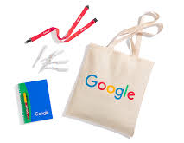
Business Questions
How did the store perform in converting visitors into purchasers so far this year?
What are the top selling items and which products are generating the highest revenue?
Which countries have the most users and how can we expand our reach into countries with vast market potential?
How can we leverage device data to strategically optimize our marketing efforts and expand our market segment?

Slide 4

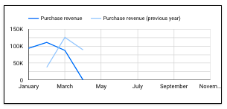
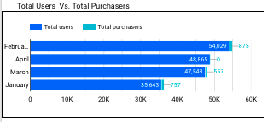
How did the store perform in converting visitors into purchasers so far this year?
Revenue is down from last year.
March 2023: $125,696.00
March 2024: $87,527.00
Purchase conversion rate is low.
Only 1% of visitors are completing a purchase.
Total Users Vs. Total Purchasers
April: 48,865 Users, 0 Purchasers
March: 47,548 Users, 557 Purchasers
Recommendations: Focus on improving website engagement by increasing retention.
The Merchandise store has a large amount of visitors each month. Retention strategies should be implemented to increase purchasers and user engagement. For example, offer bundles or personalized recommendations to visitors.

Slide 5
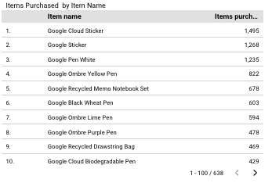

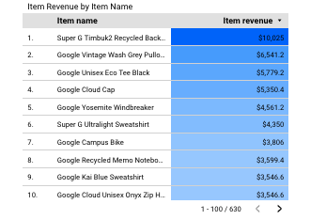
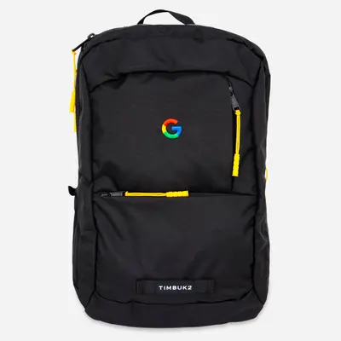
What are the top selling items and which products are generating the highest revenue?
Top Selling Items:
Google Cloud Sticker
Google Sticker
Google Pen (White)
Google Pen (Ombre Yellow)
Google Recycled Memo Notebook Set
Top Revenue Items:
Super G Timbuck2 Recycled Backpack
Google Vintage Wash Grey Pullover
Google Unisex Eco Tee Black
Google Cloud Cap
Google Yosemite Windbreaker
Recommendations: Bundle items that generate the most revenue with top selling items.

Slide 6
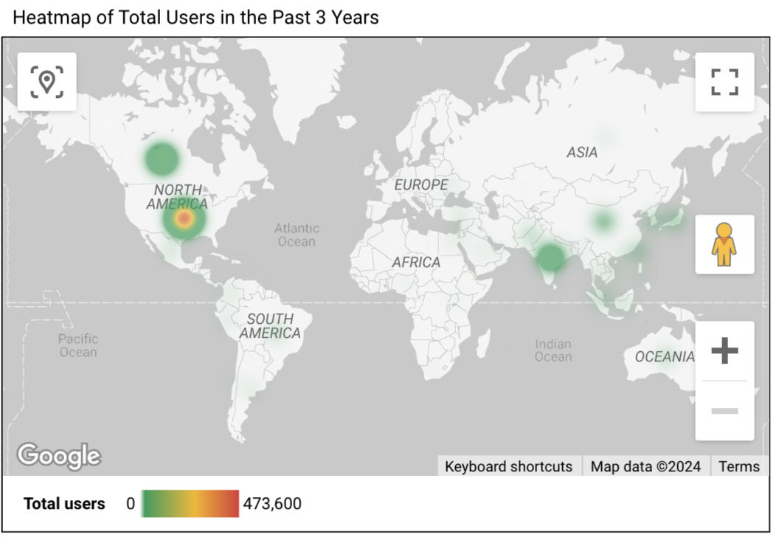
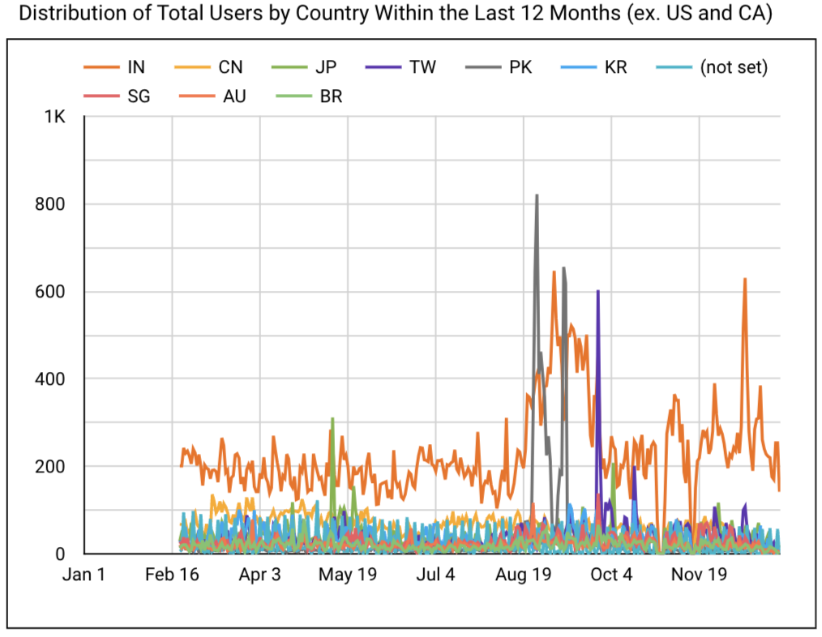
International User Demographics: Insights by Country
Which countries have the most users and how can we expand our reach into countries with vast market potential?
Countries with highest total users: USA, Canada, India, China, and Japan
Recommendation: Focus marketing efforts in India - vast market potential for our products
Notes:
Since we have a stronghold of North American users, we should focus our efforts on expanding user count in India, China, and Japan as they have a vast market for our products.

Slide 7
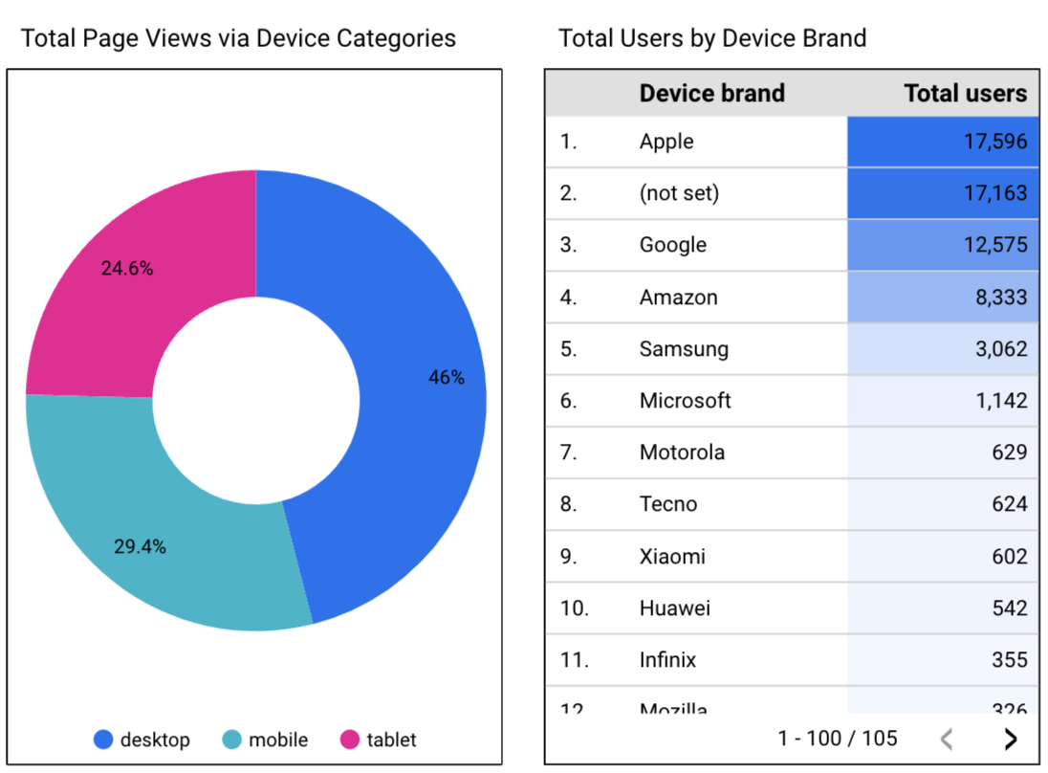
Device Demographics: Understanding User Devices
How can we leverage device data to strategically optimize our marketing efforts and expand our market segment?
Most popular device brands in India
Brand | Operating System
1. Samsung | Android
2. Google | Android
3. Xiaomi / Realmi | Android
4. Oppo | Android
5. Apple | iOS
Source: India Smartphone Shipments Market Data (Q3 2022 – Q4 2023), Counterpointresearch.com
Recommendation: Improve user experience and increase targeted ads for Android device users in India

Slide 8
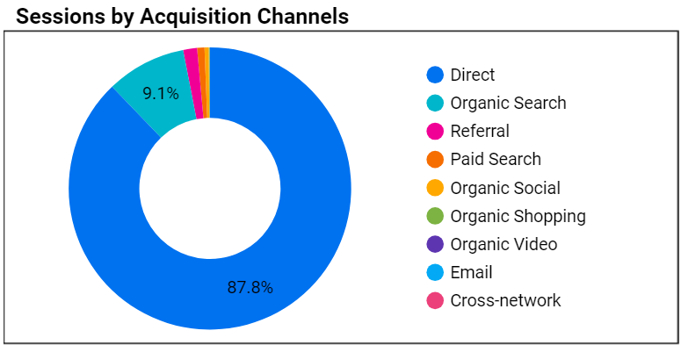
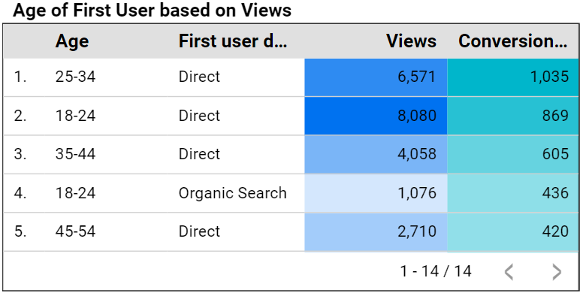
Acquisition
Which acquisition channels are generating the most traffic and who are the age demographics?
Recommendation: Focus on Direct Channels of ages 25-34

Slide 9
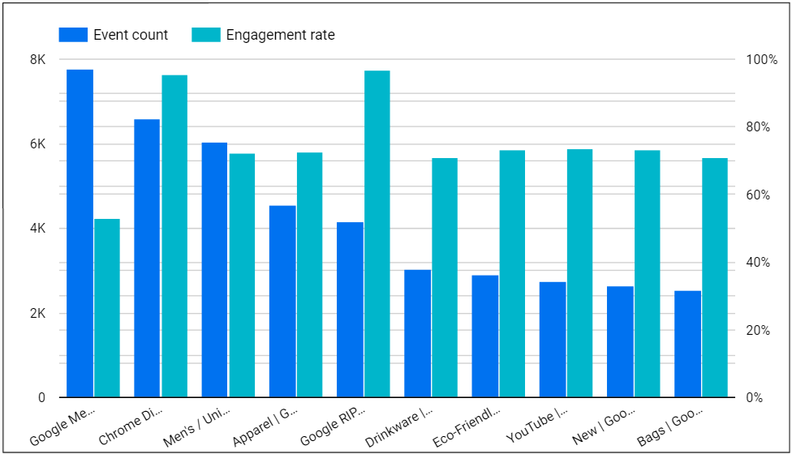
Engagement Rate
Which Pages are the most the highest event count while looking at the engagement rate?
Recommendation: Take advantage of the engagement rates to find the popular pages.

Slide 10
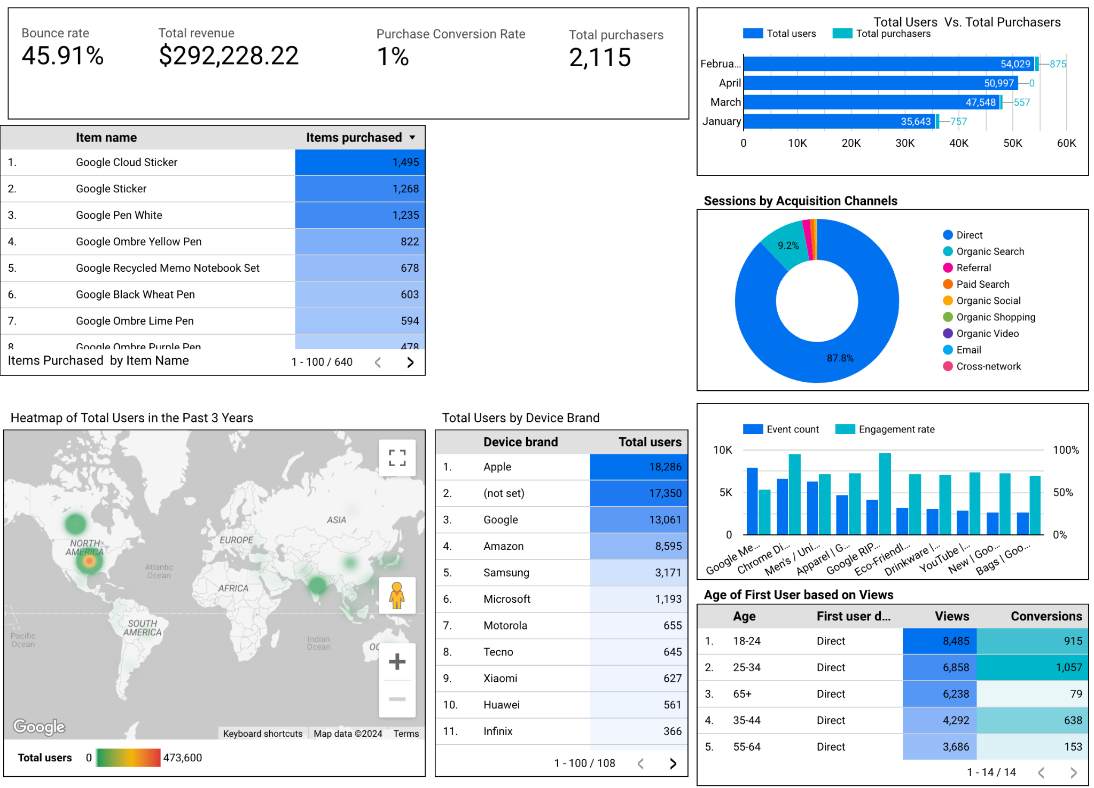

Slide 11
Conclusion & Recommendations
Encourage shoppers to purchase items that generate the most revenue by bundling high revenue items with the most popular items. For example, bundle the backpack with a pen and notebook.
Focus on improving website engagement by increasing retention. The Merchandise store has a large amount of visitors each month. Retention strategies should be implemented to increase purchasers and user engagement. For example, offer bundles or personalized recommendations to visitors.
With a stronghold in North America, we should expand marketing efforts in India, as there is significant untapped potential to gain users in this country. Increase targeted ads and optimize user experience on popular devices.

